Slide 1
Lecture 12
CS404: Software Engineering
Software Testing and Quality Assurance
Software Engineering: A Practitioner’s Approach, 7/e
by Roger S. Pressman
Slides copyright © 1996, 2001, 2005, 2009 by Roger S. Pressman
Software Engineering 9/e
By Ian Sommerville

Slide 2
Contents
Dynamic Testing
Black Box Testing
BOUNDARY VALUE ANALYSIS (BVA)
White Box Testing
LOGIC COVERAGE CRITERIA
BASIS PATH TESTING

Slide 3
Dynamic Testing
Program must be run during testing phase
Tester may or may not have access to codebase while testing
Black-Box Testing techniques are used when tester does not have access to source code
White-Box Testing techniques are used when tester has access to source code

Slide 4
Contents
Dynamic Testing
Black Box Testing
BOUNDARY VALUE ANALYSIS (BVA)
White Box Testing
LOGIC COVERAGE CRITERIA
BASIS PATH TESTING

Slide 5
Black Box Testing
Tester
Does not have access to the codebase
Has access to requirements and the problem to be solved
We need to:
To test the functional validity of the software so that incorrect or missing functions can be recognized
To test the modules independently
Techniques:
BOUNDARY VALUE ANALYSIS (BVA)
Others (e.g., Cause-effect graphing technique, State table-based testing, Decision table-based testing etc.)

Slide 6
Contents
Dynamic Testing
Black Box Testing
BOUNDARY VALUE ANALYSIS (BVA)
White Box Testing
LOGIC COVERAGE CRITERIA
BASIS PATH TESTING

Slide 7
BOUNDARY VALUE ANALYSIS (BVA)
Uncovers the bugs at the boundary of input values
BOUNDARY VALUE CHECKING (BVC)
ROBUSTNESS TESTING METHOD
WORST-CASE TESTING METHOD

Slide 8
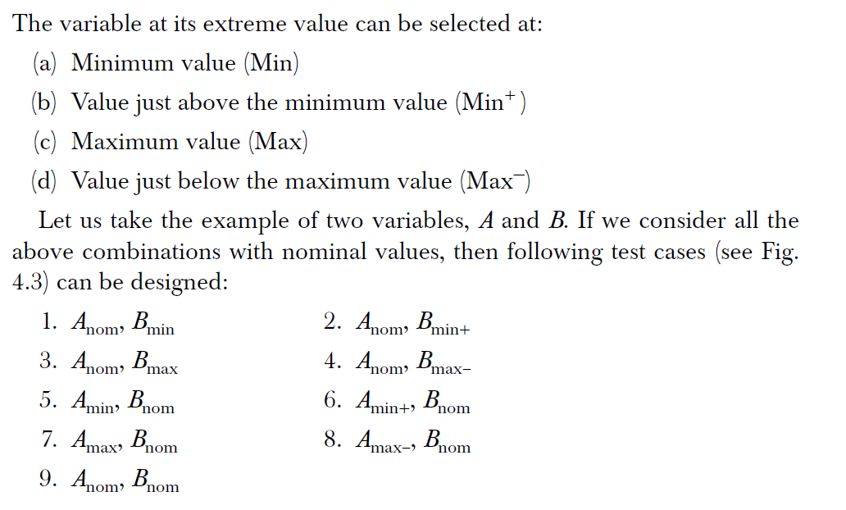
BOUNDARY VALUE CHECKING (BVC)

Slide 9
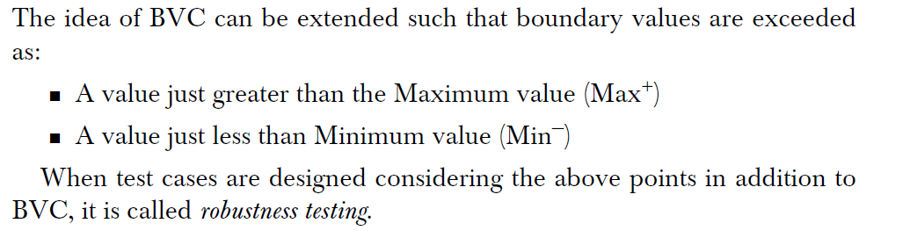
ROBUSTNESS TESTING METHOD

Slide 10
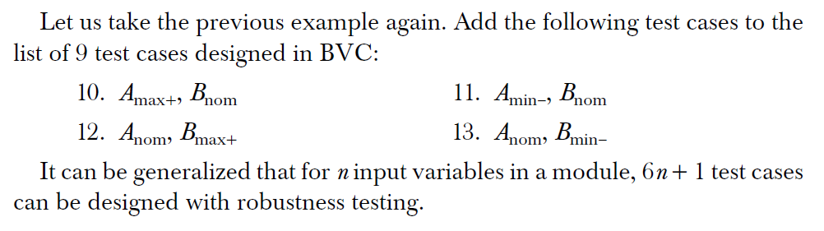
ROBUSTNESS TESTING METHOD …

Slide 11
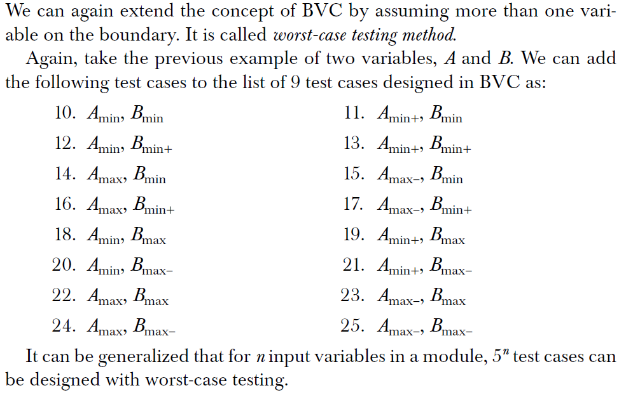
WORST-CASE TESTING METHOD

Slide 12
Contents
Dynamic Testing
Black Box Testing
BOUNDARY VALUE ANALYSIS (BVA)
White Box Testing
LOGIC COVERAGE CRITERIA
BASIS PATH TESTING

Slide 13
White Box Testing
Tester has access to the codebase
Must be done prior to Black Box Testing
Techniques:
Logic Coverage Criteria
Basis Path Testing

Slide 14
Contents
Dynamic Testing
Black Box Testing
BOUNDARY VALUE ANALYSIS (BVA)
White Box Testing
LOGIC COVERAGE CRITERIA
BASIS PATH TESTING

Slide 15
LOGIC COVERAGE CRITERIA
Test cases are designed based on the logic of the program such that every element of the logic is covered
Statement Coverage
Decision/condition Coverage

Slide 16
Statement Coverage
Consider if all statements are executed once, every bug will be notified
Not enough to cover logic
scanf (“%d”, &x);
scanf (“%d”, &y);
while (x != y)
{
if (x > y)
x = x – y;
else
y = y – x;
}
printf (“x = ’’, x);
printf (“y = ’’, y);
Test case 1: x = y = n, where n is any number
Test case 2: x = n, y = n’, where n and n’ are different numbers.
Test case 3: x > y
Test case 4: x < y

Slide 17
Decision/condition Coverage
Each condition in a decision must take on all possible outcomes at least once
scanf (“%d”, &x);
scanf (“%d”, &y);
while (x != y)
{
if (x > y)
x = x – y;
else
y = y – x;
}
printf (“x = ’’, x);
printf (“y = ’’, y);
If (A && B)
Test case 1: A = True, B = True
Test case 2: A = True, B = False
Test case 3: A = False, B = True
Test case 4: A = False, B = False

Slide 18
Contents
Dynamic Testing
Black Box Testing
BOUNDARY VALUE ANALYSIS (BVA)
White Box Testing
LOGIC COVERAGE CRITERIA
BASIS PATH TESTING

Slide 19
BASIS PATH TESTING
Path testing
is based on control structure of the program for which flow graph is prepared.
requires complete knowledge of the program’s structure.
is closer to the developer and used by him to test his module.
Choose enough paths in a program such that maximum logic coverage is achieved.

Slide 20
CONTROL FLOW GRAPH
Node It represents one or more procedural statements. The nodes are denoted by a circle. These are numbered or labeled.
Edges or links They represent the flow of control in a program. This is denoted by an arrow on the edge. An edge must terminate at a node.
Decision node A node with more than one arrow leaving it is called a decision node.
Junction node A node with more than one arrow entering it is called a junction.
Regions Areas bounded by edges and nodes are called regions. When counting the regions, the area outside the graph is also considered a region.

Slide 21
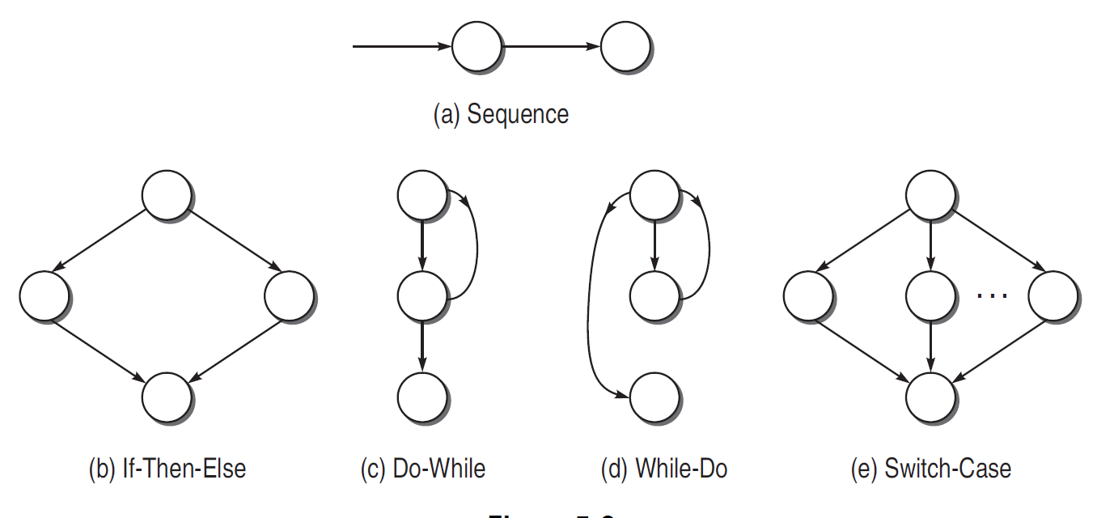
FLOW GRAPH NOTATIONS

Slide 22
PATH TESTING TERMINOLOGY
Path A path through a program is a sequence of instructions or statements that
starts at an entry, junction, or decision and
ends at another, or possibly the same, junction, decision, or exit.
A path may go through several junctions, processes, or decisions, one or more times.
Length of a path The length of a path is measured by the number of links in it and not by the number of instructions or statements executed along the path.
An alternative way to measure the length of a path is by the number of nodes traversed. This method has some analytical and theoretical benefits. If programs are assumed to have an entry and an exit node, then the number of links traversed is just one less than the number of nodes traversed.

Slide 23
PATH TESTING TERMINOLOGY
Independent path An independent path is any path through the graph that introduces at least one new set of processing statements or new conditions.
An independent path must move along at least one edge that has not been traversed before the path is defined

Slide 24
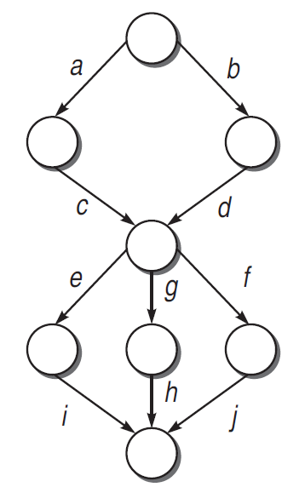
CYCLOMATIC COMPLEXITY
Cyclomatic complexity is expressed using a Cyclomatic number
Cyclomatic number is the number of independent paths in the control flow graph
The given flow graph has 6 possible paths:
acei
acgh
acfj
bdei
bdgh
bdfj
Only 4 of them independent

Slide 25
CYCLOMATIC COMPLEXITY
Assuming that graph has one component
Cyclomatic Complexity:
V(G) = e – n + 2
V(G) = d + 1
V(G) = number of regions in the graph
assume that a k-way decision point contributes for k − 1 choice points

Slide 26
End of lecture 12

